Slide 1

Data Science – The Sexiest Job of the 21st century? Reality vs. Myth
FriYay-Talk Data Science Beach Camp
BEACHUB, Koh Phangan, July 5th, 2019
Stefan Rustler, Founder & CEO

Slide 2

FriYay-Talk Agenda
Introduction:
What is a Data Scientist?
How has the role changed?
Interactive Part:
Myth vs. Reality

Slide 3


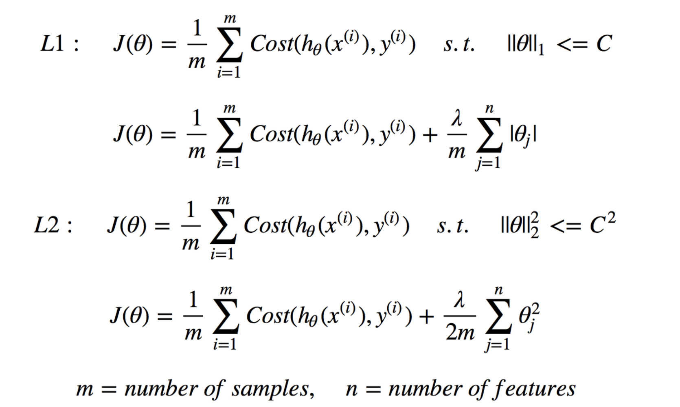
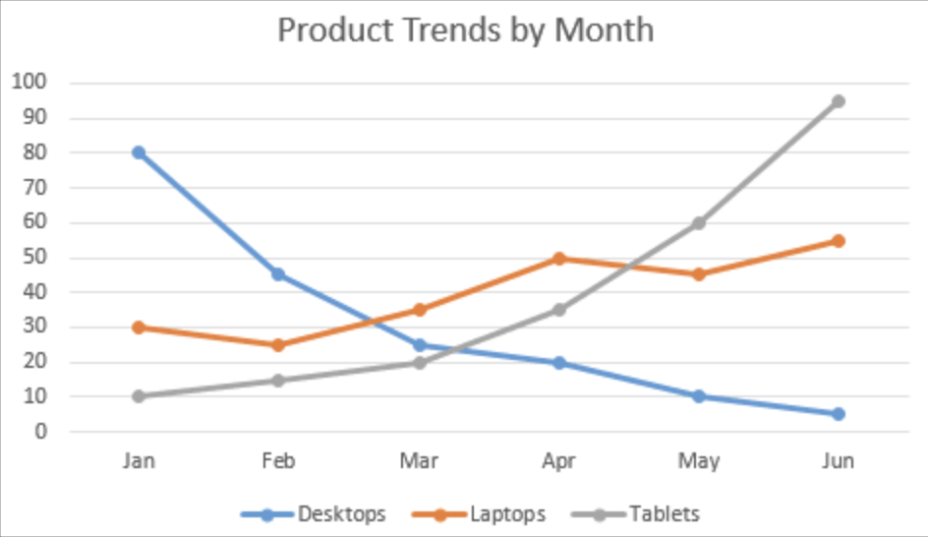
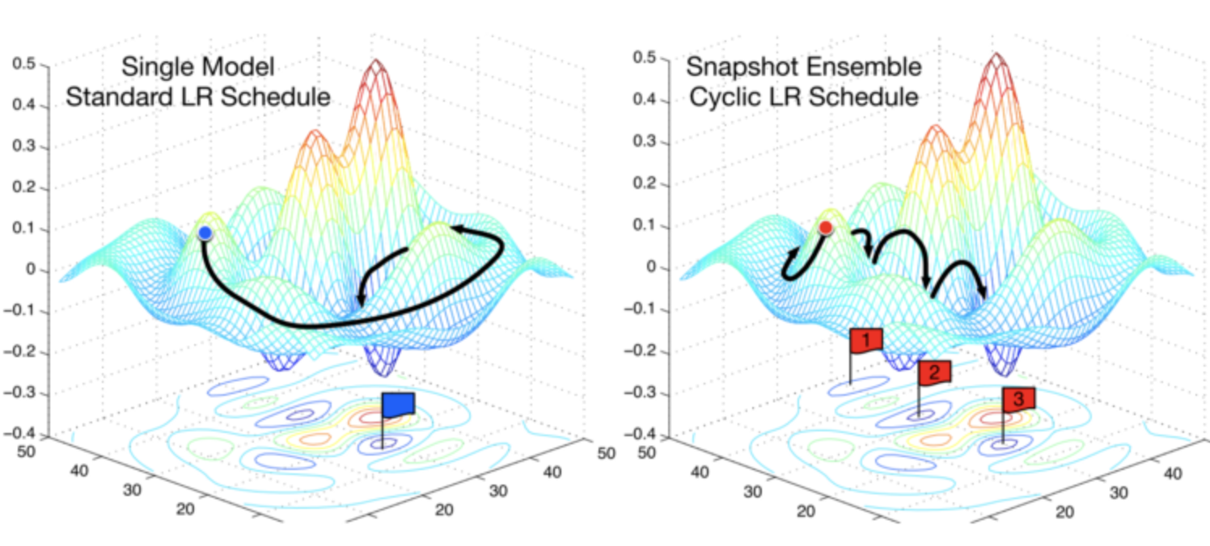
Data Scientists…
Who are they?
What my friends think I do
What my boss thinks I do
What my society thinks I do
What I think I do
What other coders think I do
What I actually do
SELECT spending
FROM db.user

Slide 4
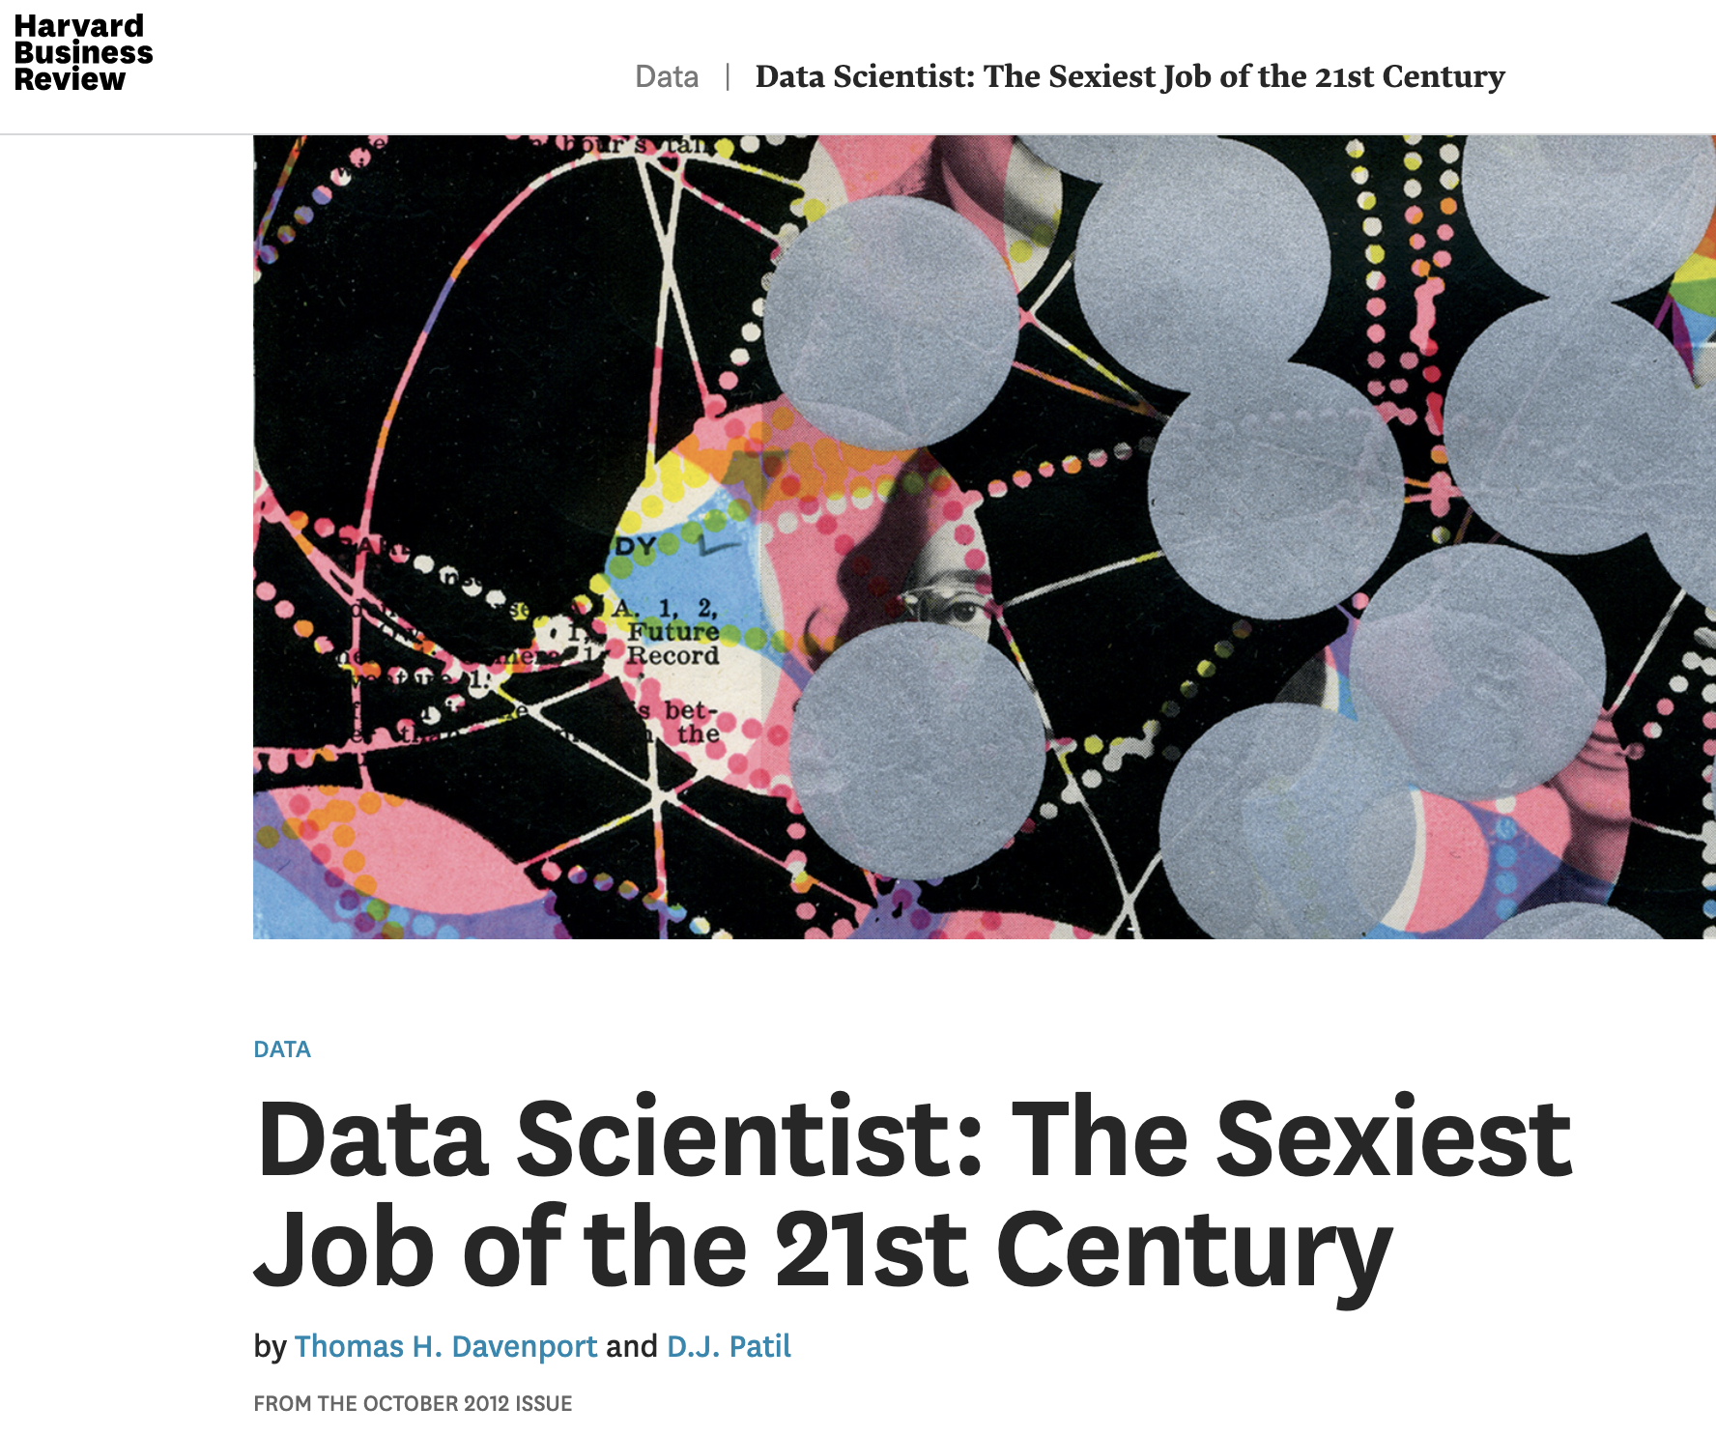
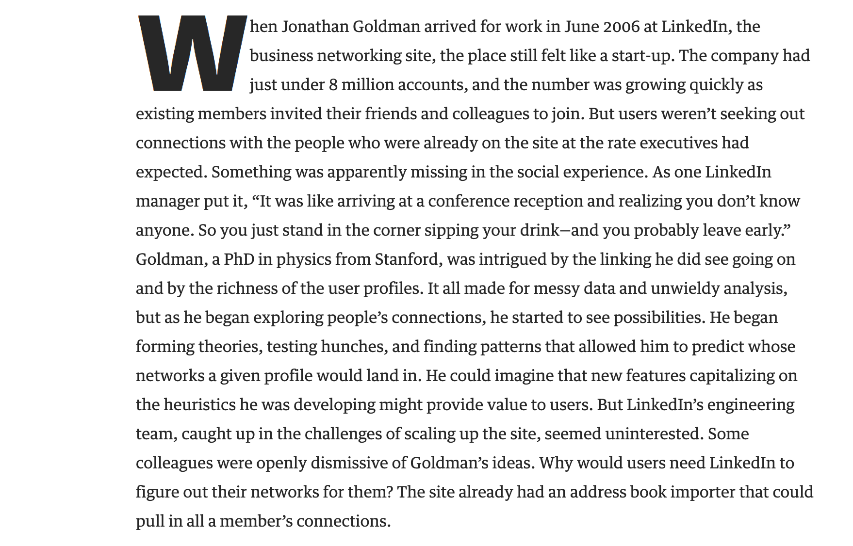

Landmark Article on Data Scientists in 2012
Introduction
Core statements on Data Scientists
They are a “new bread” that are key to creating value from big data.
As companies wrestle with unprecedented volumes and types of information, demand for them has raced well ahead of supply.
They bring structure to data, find patterns, and advise executives on the implications for products, processes, and decisions.
They bring a novel scientific perspective to bring about innovation to data-heavy topics, e.g. DNA models for fraud detection.
What makes a Data Scientist?
Ability to build a prototype in common coding language
Solid math/stats and CS foundation
Feel for business issues + empathy with customers
Then only on-the-job training!
Source: https://hbr.org/2012/10/data-scientist-the-sexiest-job-of-the-21st-century

Slide 5
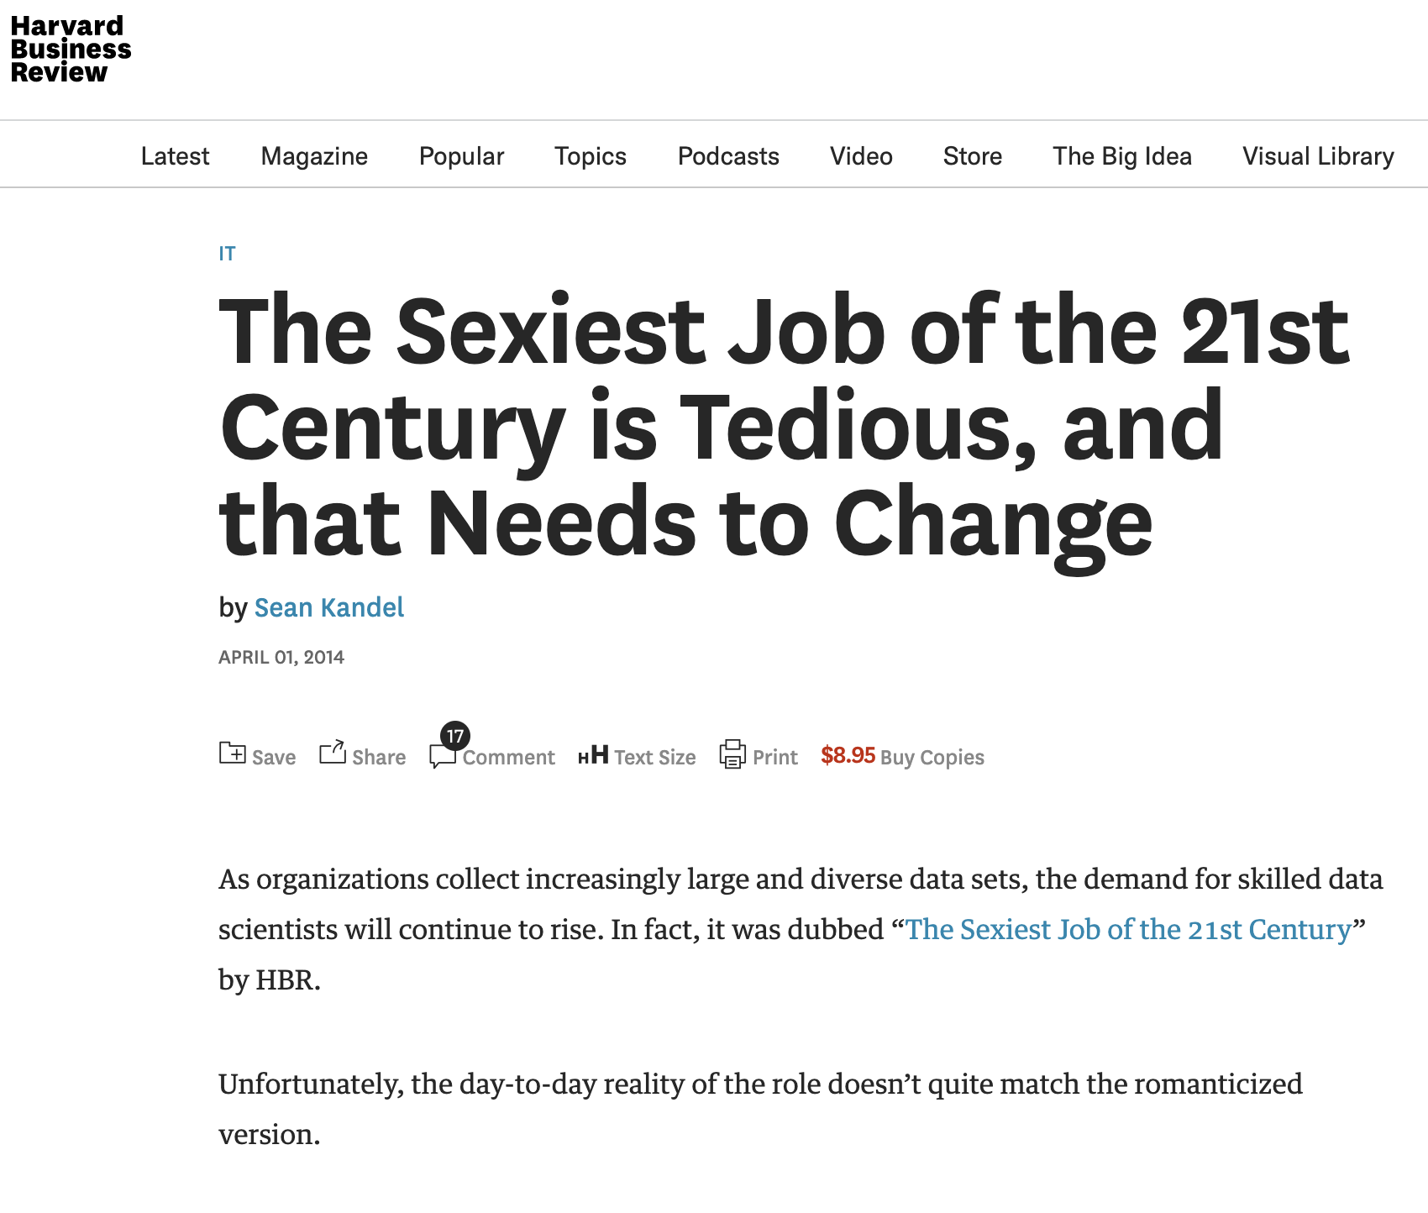
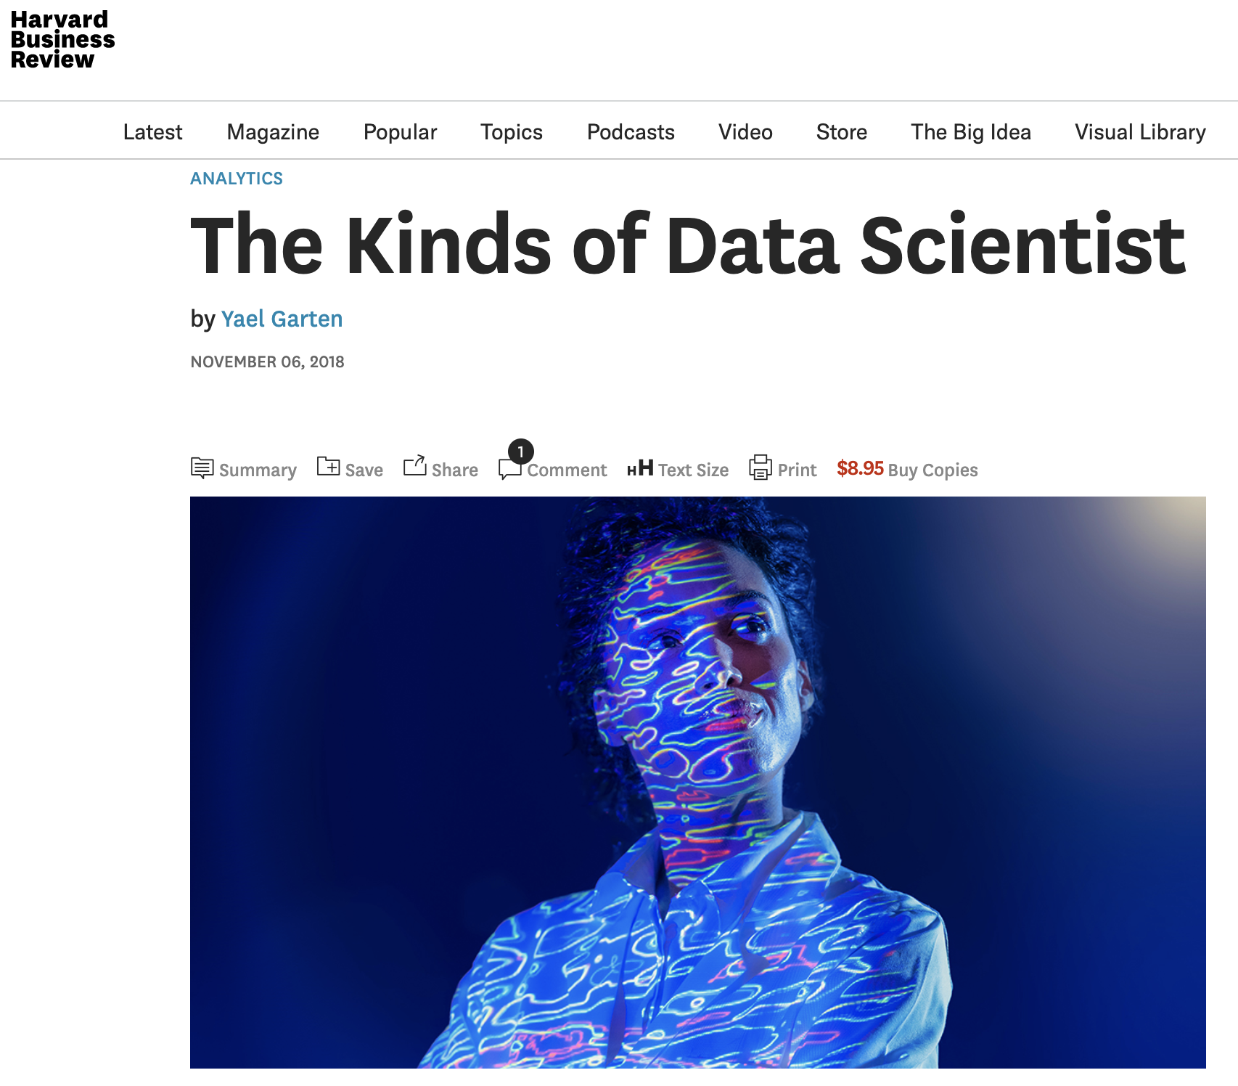
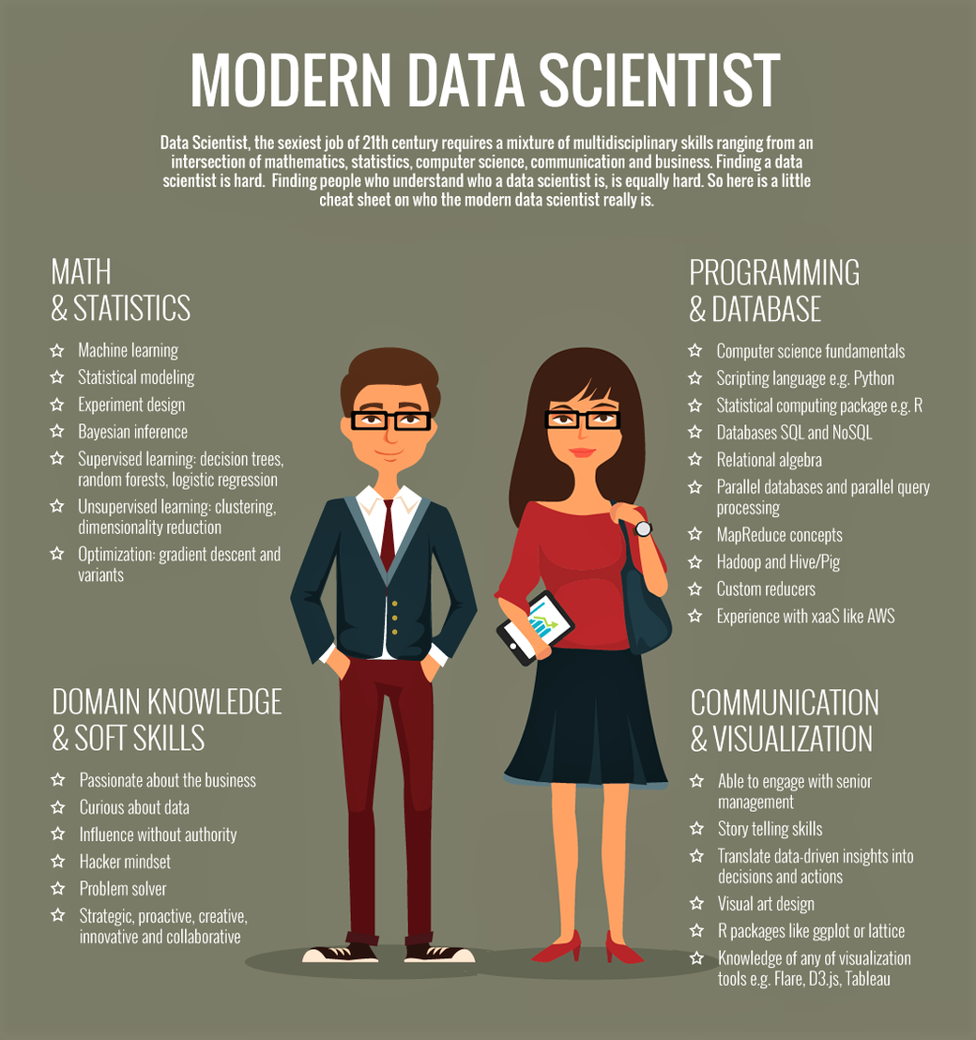
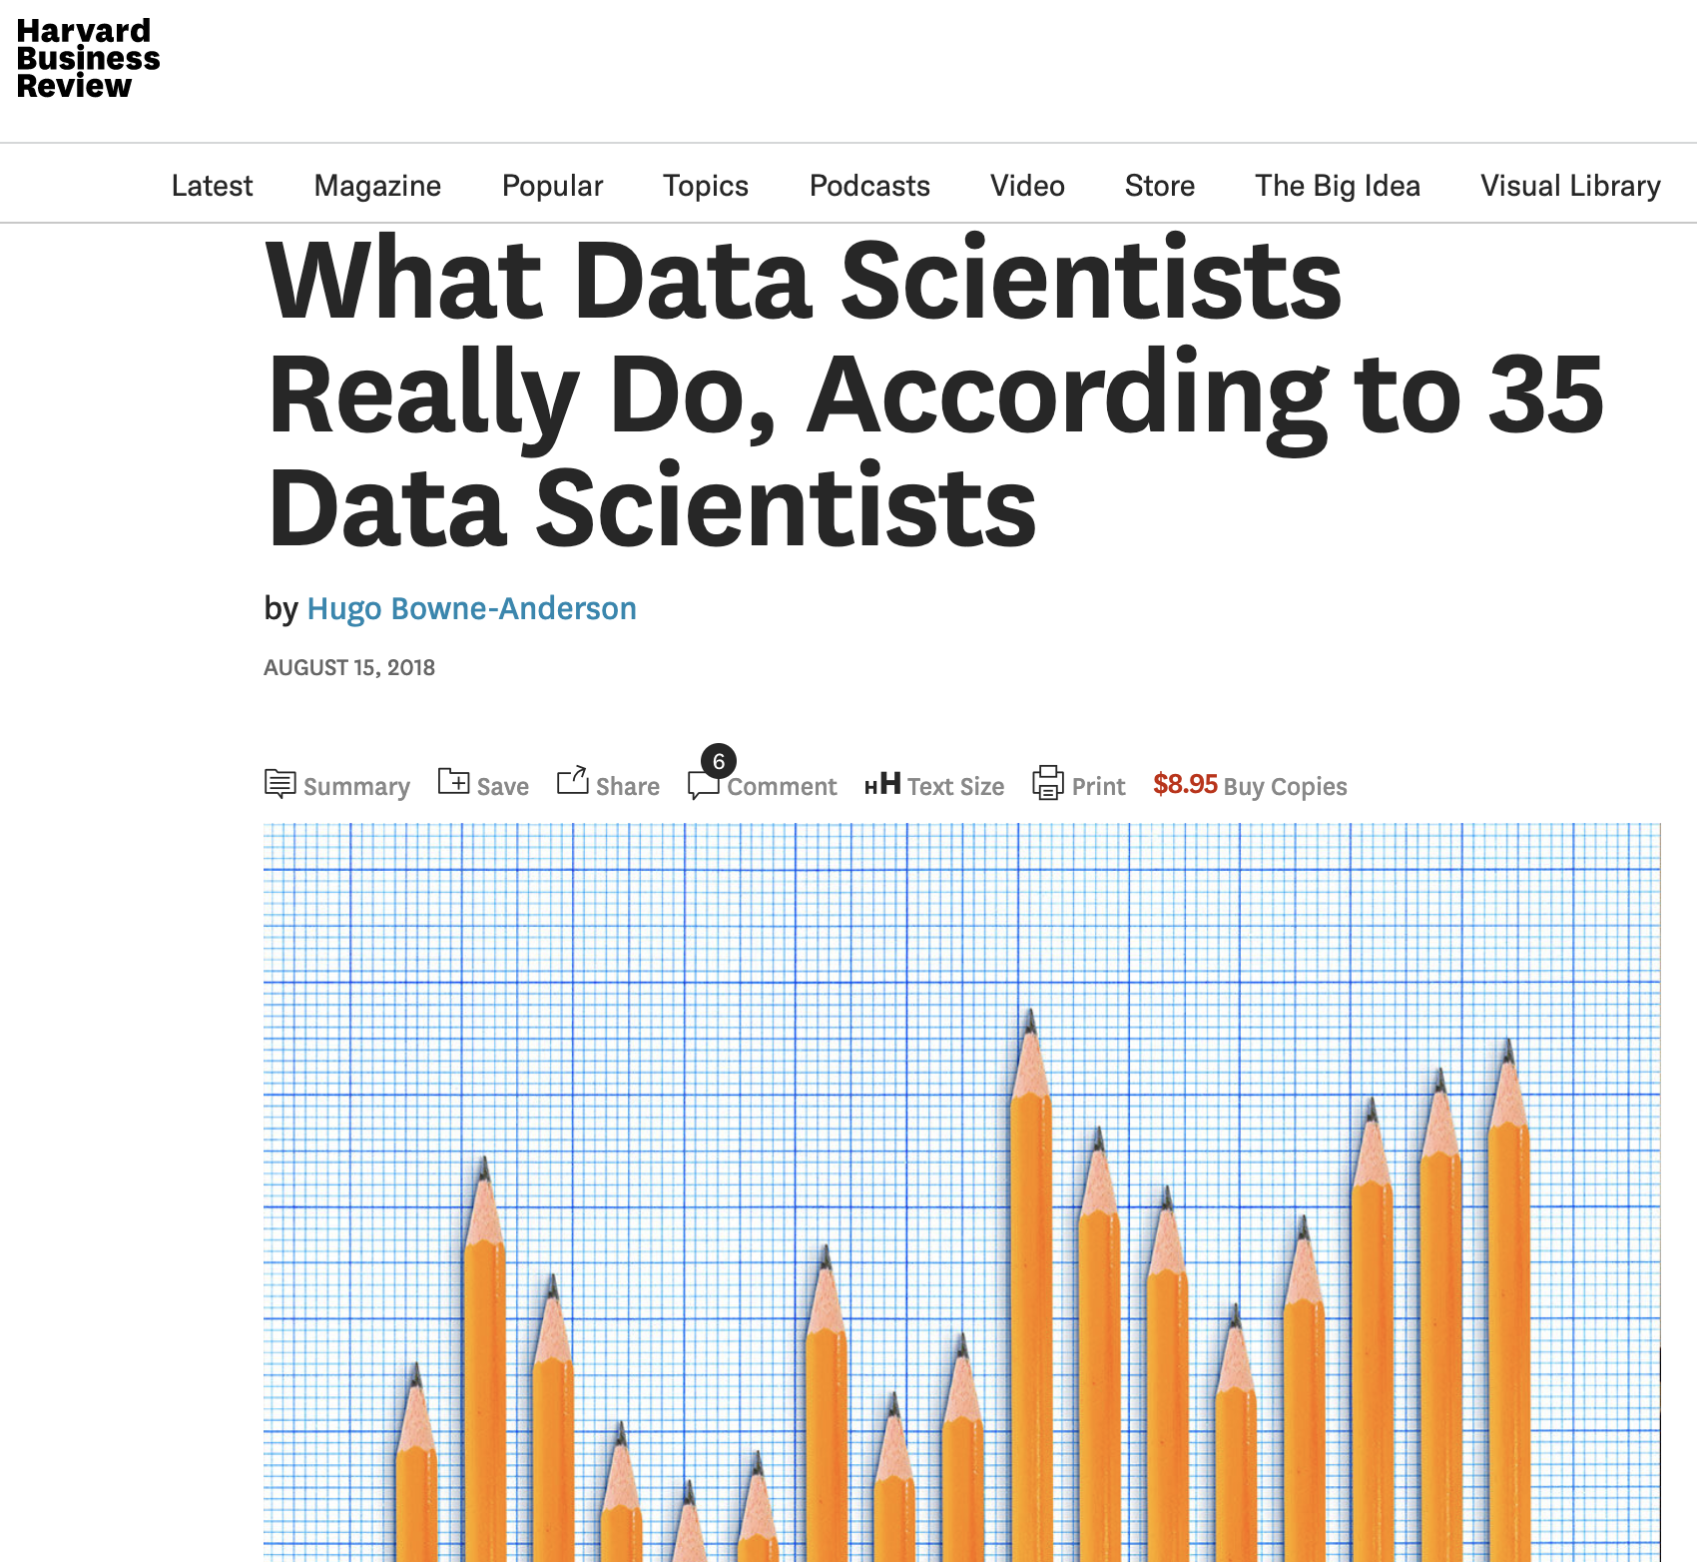
The role of Data Scientists has been changing and refined since then
Introduction

Slide 6




Data Scientists combine a little bit of several key areas
Introduction
Statistics
Programming
Storytelling
Domain knowledge

Slide 7
What makes the Modern Data Scientist?
Introduction
A combination of four areas is needed
Math & statistics
Programming & databases
Domain knowledge →Trend to train rather than hire
Communication & visualization →Analytics Translators emerge
What we cover at DSBC
Machine learning fundamentals
Supervised learning: Logistic regression
Unsupervised learning: Clusterting, dimensionality reduction
Optimization: gradient descent
And much more: Neural Networks, Support Vector Machines etc.
Source: https://ciselab.jimdo.com/

Slide 8
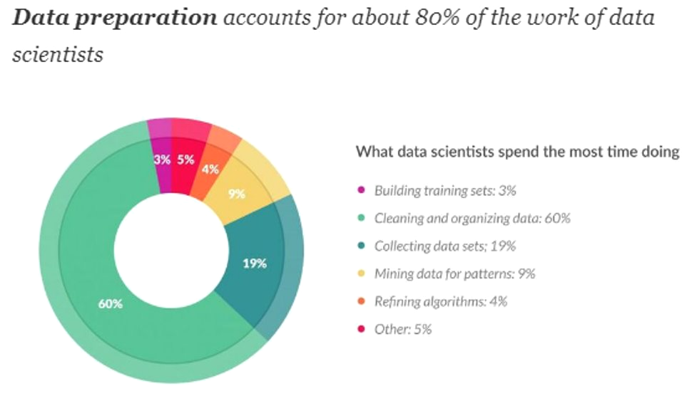
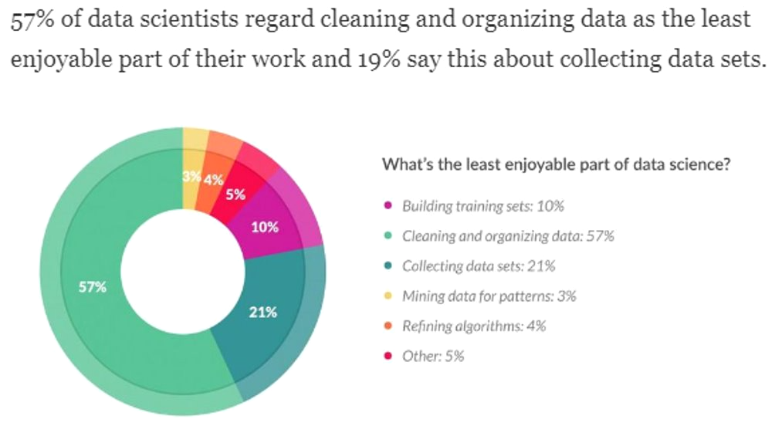
What do Data Scientists really do?
Introduction
Cleansing and organization of data takes up most time and is also least enjoyed by data scientists.
The profile might not be so sexy after all, yet it is so highly sought after. Why is that?
Source: https://www.forbes.com/sites/gilpress/2016/03/23/data-preparation-most-time-consuming-least-enjoyable-data-science-task-survey-says

Slide 9
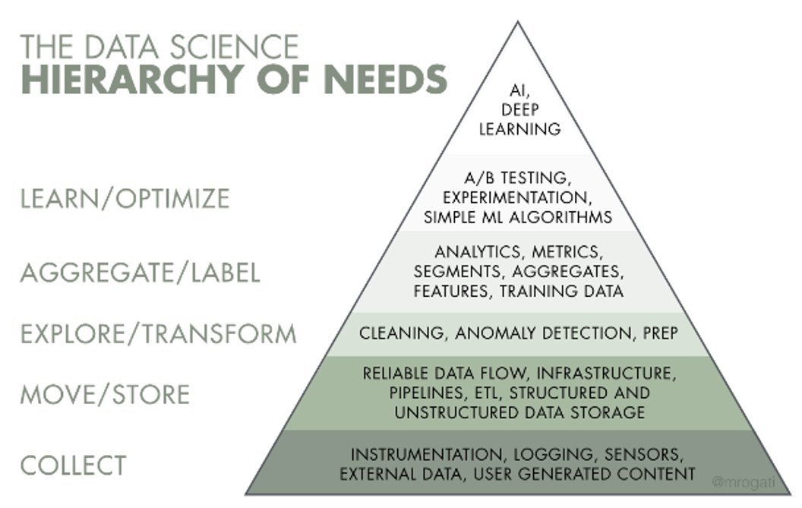
The Role of a Data Scientist is still not well defined and many Organizations do not yet do it right.
Introduction
Maslow’s hierarchy of needs: You first need food, water and shelter (data literacy, collection and infrastructure) before you do self-actualization (AI)
Companies often start too far up the pyramid​ such that data scientists find themselves dealing with issues in the “foundation”
Many projects aimed at enabling AI (or better Advanced Analytics) are focused around building the infrastructural and organizational foundation
Source: https://www.simplypsychology.org/maslow.html

Slide 10
Myth or Reality?
Interactive Part
“The more sophisticated the algorithm the better the prediction. Developing a powerful algorithm is the hardest part.”

Slide 11
Myth or Reality?
Interactive Part
“It’s not who has the best algorithm that wins.
It’s who has the most data.”

Slide 12
Myth or Reality?
Interactive Part
“A good programmer will be a good data scientist.”

Slide 13
Myth or Reality?
Interactive Part
“Deep mathematical understanding is
quintessential for a data scientist.”

Slide 14
Myth or Reality?
Interactive Part
“Domain knowledge is equally important for data scientists
than programming and mathematical skills.”

Slide 15
Myth or Reality?
Interactive Part
“Strong communication and story telling skills
are important skills of a data scientist.”

Slide 16
Myth or Reality?
Interactive Part
“Any company that works with data will
eventually need to employ data scientists.”

Slide 17
Myth or Reality?
Interactive Part
“Data science is overly hyped and will eventually wane off.”

Slide 18
Myth or Reality?
Interactive Part
“Artificial Intelligence will eventually kill humankind.”

Slide 19


Thank you!
See for next week’s Friyay Talk on:
“
Data Science in Action
Anti-Money Laundering Analytics at a Swiss Bank
”
→ datasciencebeachcamp.com
→ facebook.com/datasciencebeachcamp

Slide 20
Myth or Reality?
Interactive Part
“The most successful data scientists have
PhD’s in very quantitative fields.”

Slide 21
Myth or Reality?
Interactive Part
“A data scientist must be fluent in
multiple programming languages and software tools.”

